Slide 1
Life of an Anaesthesiologist after Post Graduation
Dr.AL.Meeenakshi sundaram MD DA
Dean
Government Medical College
Pudukkottai, TamilNadu
GC Member, ISA National (2009-2012)
Vice President, ISA National (2016)

Slide 2
Popular saying
Beaten iron becomes the steel
Tortured students become doctors
Tortured and Frustrated Doctor becomes a Post graduate
Or else after PG he may become frustrated/ tortured

Slide 3


Where to go?
Go for freelance
Go for government service
Go for central service
Go for corporate
Go for research
Go for teaching

Slide 4
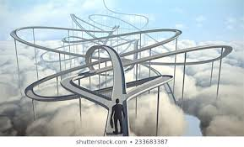
You should not be confused like this

Slide 5


Freelance
You are the master and servant
Free time may be there if you wish
You are wholly dependant (Only one wife)
Money may flow but soon it would dry..
Only time varies
You may even be taken for granted

Slide 6

Government service …Back up is there !!!

Slide 7

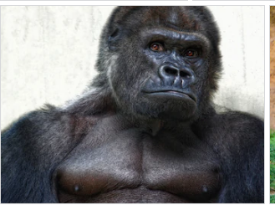
Government service
Assured salary
Leave allowed
Less supervision
Transfers may be there
HOD problem
Administrator problem

Slide 8
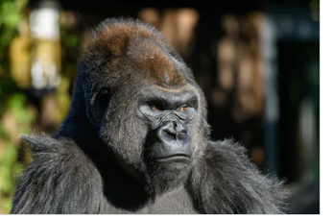
Central service
Assured salary
No private practice
Transfers—far off places
Boredom—some times
Administrator problems

Slide 9
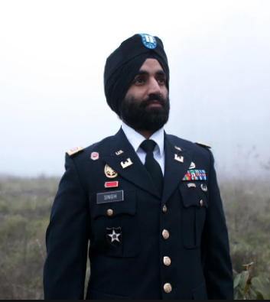
Army service
Assured salary/Perks
No private practice
Transfers—far off places
Boredom—you cant come back to civilian side some times
Administrator problems

Slide 10

Corporate service
Glass house …disease palaces
Monthly salary
No consumer council
Admin may or may not defend
Admin pressure may be there
No job security

Slide 11
Teaching//Education
Future require robust commitment to education
Increasing just the quantity dilutes quality!
UG and PG level Education
Applied Respiratory and Cardiovascular Physiology
Neural Science and Pharmacology
Resuscitation and Emergency airway Management

Slide 12

Research
Anaesthesiology has a vibrant history of research
and intellectual contribution
Research involves mechanisms of complex behaviours e.g. consciousness, memory and pain
Recent advances in cellular biology... a new ray of hope

Slide 13

Research
Innovative anaesthesia training programmes are offering integrated scholarship aid to most residents
Several graduates are pursuing fellowships in clinical and traditional research
The application of information technology (AI) and epidemiologic techniques to the perioperative period has also created opportunities for research

Slide 14
Research and pharma company placement
Academically interesting
Monetary reward may or may not be there
Conflict of interest
Pressure by sponsors?

Slide 15
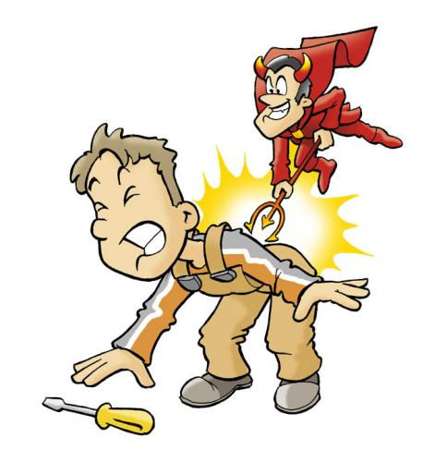
Pain Physicians
Private Practice
Monetary reward
Incubation period is too long
Costly gadgets needed

Slide 16
Pain Physician / Pain specialist
Often engaged in acute pain management of surgery
Comfortable with opiates , both because of their knowledge in pharmacology and also experience in managing side effects
Pioneered regional anaesthetic techniques many of which are applicable in chronic pain relief and labour pain relief
Direct access as well as recognition from the public
We can take care of acute pain services or take over as leader of a established pain clinic

Slide 17
Pain Physician / Pain specialist-- Requirements
Understand pathophysiology of pain, treatment modalities, Narcotic drug act
The physical principles involving the equipment used for pain therapy or neurolytic therapy
The basic principles of nerve conduction and also conductivity of the nerves to perform the neurolytic blocks
Get trained in ultrasound with high frequency probes

Slide 18
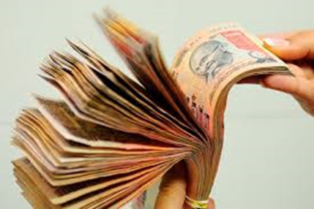

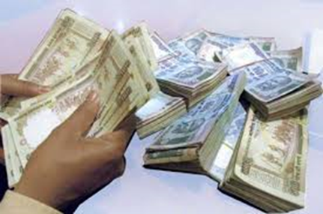
Peri operative physicians
Perioperative care costs keep increasing
But Anesthesiologists ?
Explore other possibilities

Slide 19


Peri operative Physician
Modify yourself as leader / member in perioperative care unit
Requires redefining the whole concept (i.e.) the evaluation of preoperative care and post-operative management

Slide 20
Peri operative Physician
The first and foremost goal is the commitment to provide high standards of patient care

Slide 21
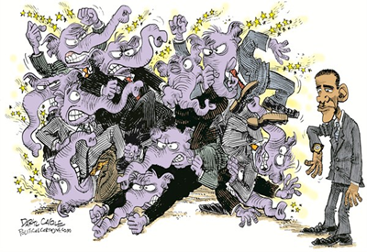
Peri operative Physician
Secondly the evidence based practice limiting unnecessary redundant services.
Educate the public about your role in Perioperative management
Make them understand that you are taking over the entire physiological control

Slide 22
Peri operative Physician
The role of anaesthesiologist in perioperative management also encloses the sub specialties pain medicine and critical care
The rational approach to perioperative pain management has positive impact on perioperative outcomes and reduces length of stay in hospitals thereby improving patient’s satisfaction

Slide 23
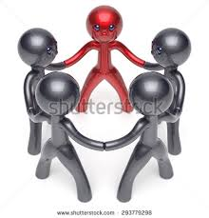
Peri operative Physician
This role has created a positive impact
Even if anaesthetists are different in the post-operative care a clear coordination will help the patient to achieve their desired goal and satisfaction

Slide 24
In this context of perioperative physician
Should be knowledgeable in attending patients with varying medical complexity with the impact of broad range of acute and chronic medical conditions
We should be aware of
  Various practice guidelines
  Regulatory requirements
  Approaches for efficient management of outpatient clinic

Slide 25

Decision to develop Pre operative Clinic
Four reasons!
1. Anticipated delay
2. Volume of surgical patients
3. Medical illness among these patients
4. Availability of clinical facilities

Slide 26
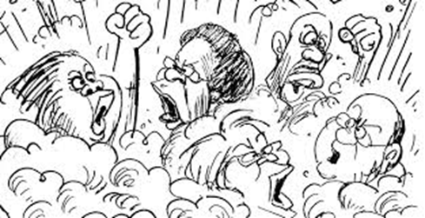
Pre operative Clinic
Anaesthesiologist should make a final decision
of whether the patient is fit for anaesthesia and surgery
Pre-operative and intra operative services are improved with anaesthesiologist
Interdepartmental opinion ?
Although many of the services are important to ensure that the patient is adequately prepared, some of them are based on tradition rather than demonstrated benefit

Slide 27

Pre operative Clinic
Reliance on non-specialist can result in
  Improper assessment
  Potential last minute surgical delay and cancellations
  Frustration for both patients and surgeons
Local hospital context is critical for any pre-operative evaluation, with which the anaesthesiologist is very familiar

Slide 28
Critical care specialist/Physician
Anaesthesiologist is well trained in invasive procedures like central venous and arterial cannulation, endotracheal intubation
In ICU mostly the same skills are required for the intensivist
Monitoring the patients under general anaesthesia helps us in redefining our roles in the management of comatose patients of ICU

Slide 29
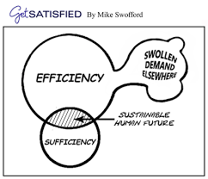

Critical care specialist/Physician
We have to increase our stake in Critical care--direct access to the patients
Leading academic programmes must expand their critical care fellowships and promote it as a financially viable and intellectually rewarding subspecialty
There is a lot of scope for increasing our reputation and recognition

Slide 30

Critical care specialist/Physician
We will be benefitted in remuneration also
We have to be fluent in internal medicine and lifesaving surgical procedures in addition to anaesthesia knowledge
We have to be emotionally very strong in facing the opposition from relatives of the patients and also the draconian consumer laws

Slide 31
Clinical Services Administration
OT is a complex environment which is often not efficiently managed
The need for effective management and administration is increasingly recognised
Anaesthesiologists are often sought for this function
There appears to be a bright future in this specialty
We have to undergo formal training in administration and management

Slide 32
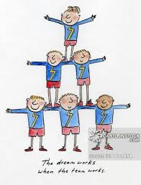
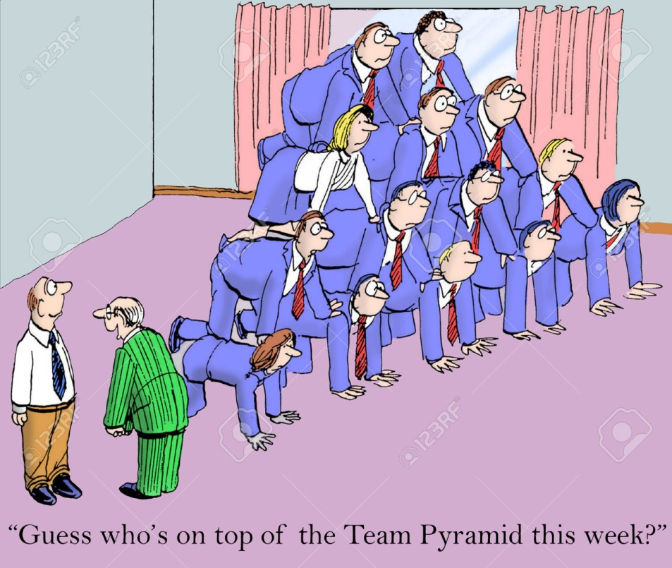
Administrator

Slide 33

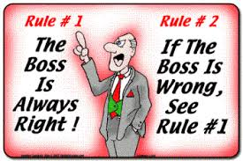

Administrator Advantage ?

Slide 34
Patient Safety Manager
Always at the forefront of pioneering patient safety
Anaesthesiologists have developed safeguards to decrease the likelihood of human errors
Examples include written check lists, audible alarms and automated anaesthesia checks.
Expertise in patient safety should be developed and translated in to broader medical context

Slide 35

Simulation Designer
Anesthesiologists led this iniative
Should continue to do it
High Profile Portfolio

Slide 36

Payment Methods--Insurance
Transition from Fee For Service (FFS) payment to alternate bundled payment methods
It has encroached on the fees of anaesthesiologist
In government Institutions Anaesthesiology
Dept is not having separate account

Slide 37

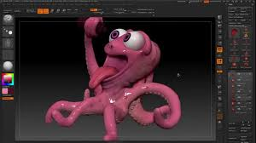
Anaesthesiology is an Octopus
Practice of anaesthesia has expanded
Gone beyond traditional operating room
Anaesthesiologists are catering to many facilities outside operating room setting.
Redefining the role of anaesthesiologist is essential in the present health care environment

Slide 38
Stress after Post Graduation ?
Lack of control of circumstances at work
Professional relationship(Surgeons)
Work overload
Threats of Litigation

Slide 39
Stress reasons for practitioners
Reviews/Video conferencing
Administrative burden
Difficult Anesthetic Cases
Night call

Slide 40
Anesthesiologist’s Stress
Uninterrupted vigilance
Immediate reaction to life threatening situations
No disease to blame !
Working inside the four walls
Surgeon already exposed and not the anesthesiologist
No second chance once the mishap has occurred
Purposely blocking protective reflexes

Slide 41
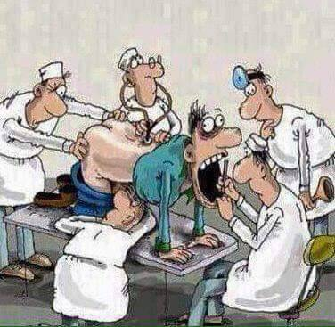
Why Stress ?
Anaesthesiologist attacked from all corners
  Involves surgeon, patient and administration

Slide 42
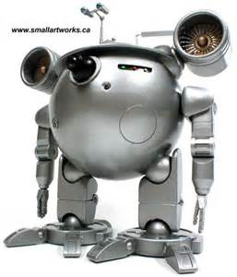
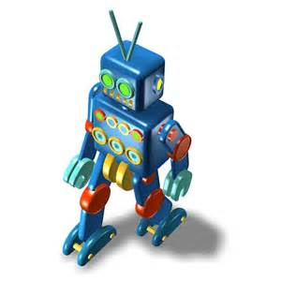
New Entrant- Convenience or Stress ??

Slide 43
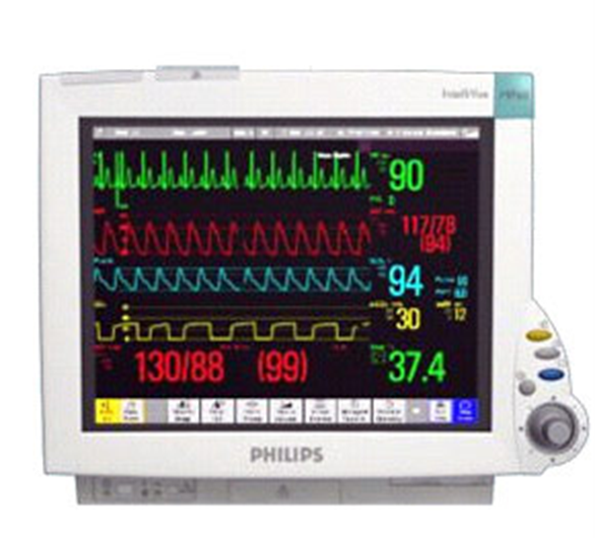
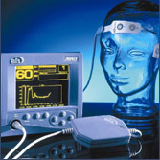
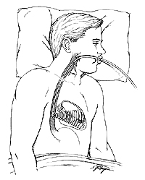
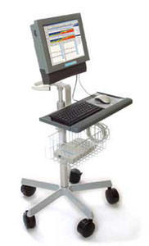
Specialized Patient Monitors?
You have to read (more ) Stress

Slide 44
Human Factors- Surgeon
Doing Laparotomy through Hernial Sac
Adrenaline Packing
Bleeding
Chatting
Delaying

Slide 45
Human Factors-- Surgeon
Blocking direct payment from patient
Not paying properly
Delaying the payment
Selection only by the quantum of payment
Obstetrician dictating the dose of oxytocin

Slide 46
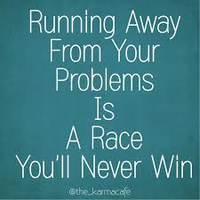
Human Factors-- Assistants
Loading wrong drugs
Not following the orders
Leaving the theatre/ICU ONLY in emergencies
Waiting for a chance ?

Slide 47
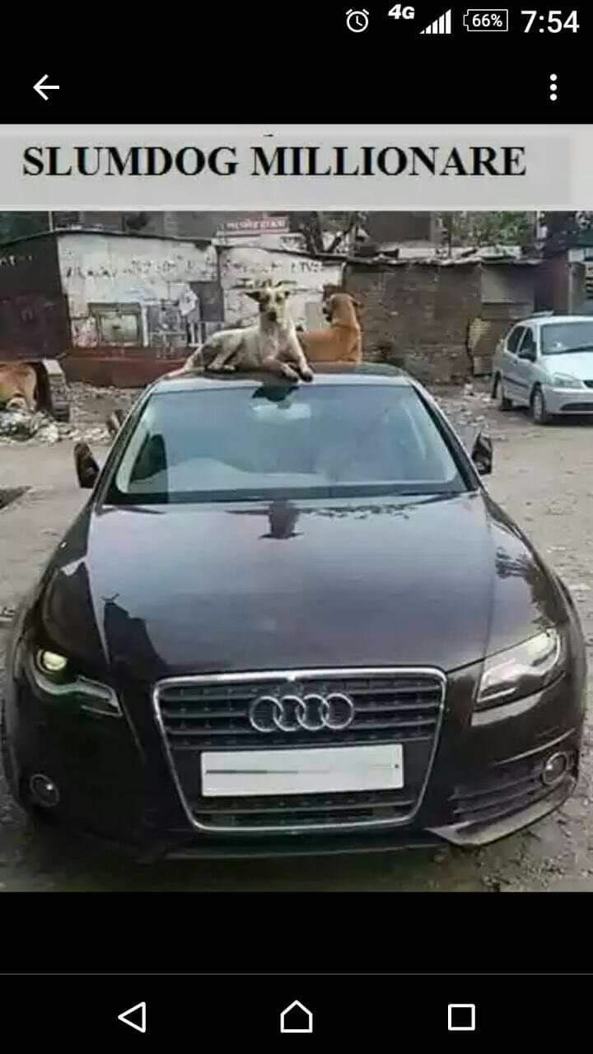
Human Factors- Anesthesiologists
Greedy
No time Management
Work Pressure
Poor decision Making
Over dependence on Assistants
Take it easy policy

Slide 48
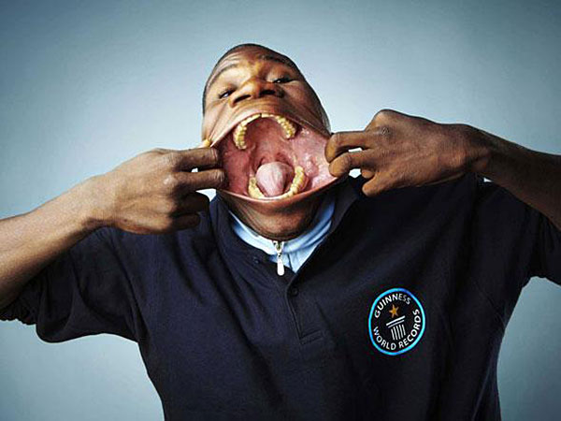
Patient factors--Ideal Patient for intubation
Intact, clear airway
Wide open mouth

Slide 49
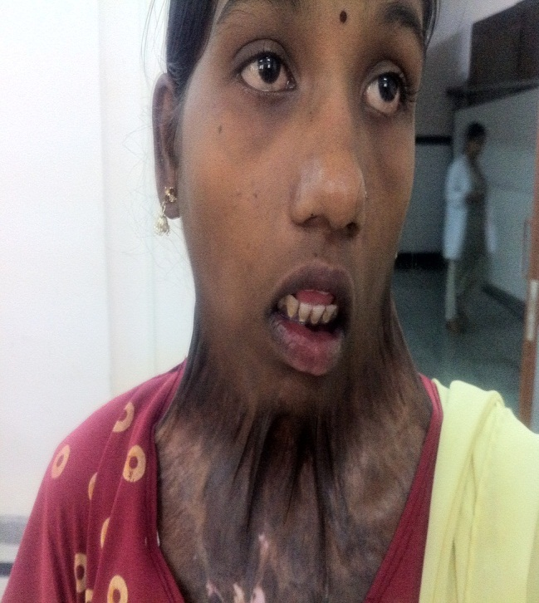
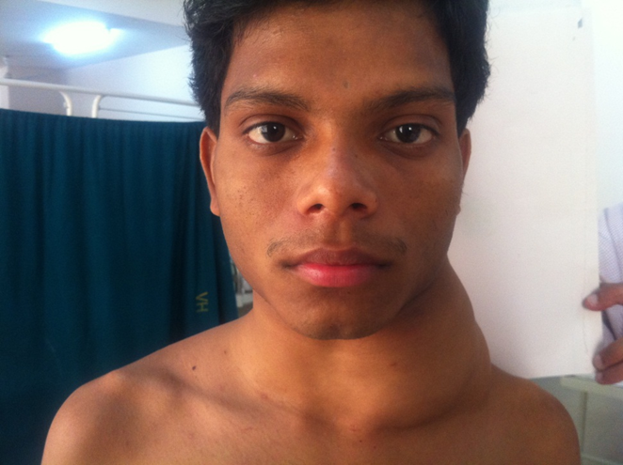
Routine (Direct) difficult Intubations

Slide 50
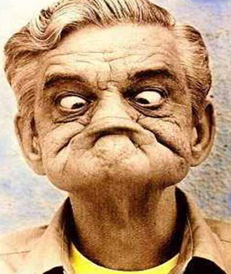
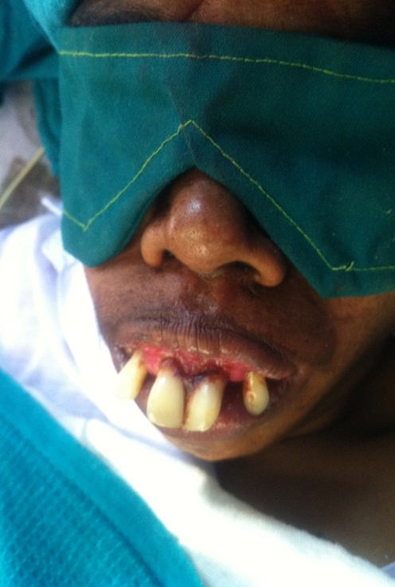
Abnormality of teeth---Stress—With or without?
Problem --Without
Problem--With

Slide 51

Healthy Means of Coping With Stress
Ability to communicate
Appropriate decision/Priority
Adequate time with family / Refuse a case and go for outing
Time for recreation(unrelated to medicine)
Money / power is not equal to happiness

Slide 52
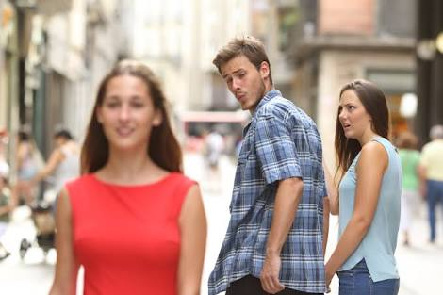
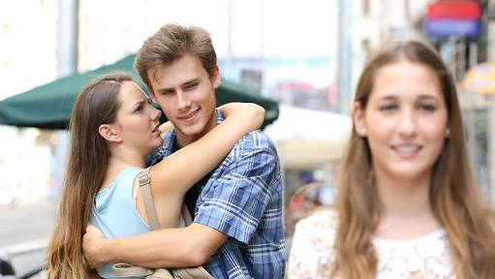
Healthy Means of Coping With Stress
Never compare yourself, your spouse ,your kids and your profession with others

Slide 53
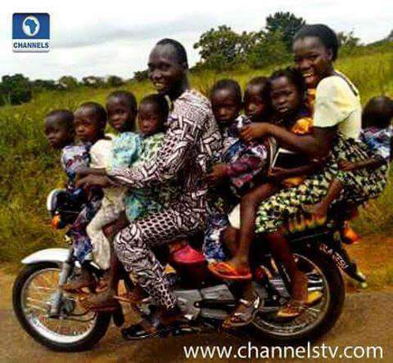
Carry home message
Many avenues
Don’t break your head in choosing one way
Remember if one door closes the other door opens

Slide 54
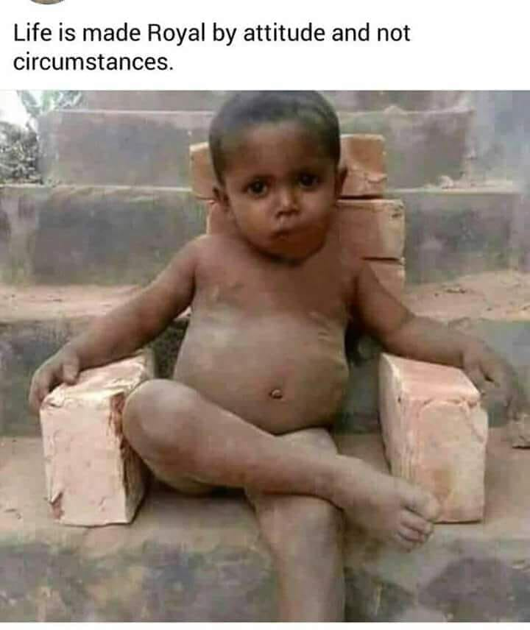
Life is made royal by attitude and not by infrastructure
As an Anesthesiologist you are born to excel and enjoy!!

Slide 55
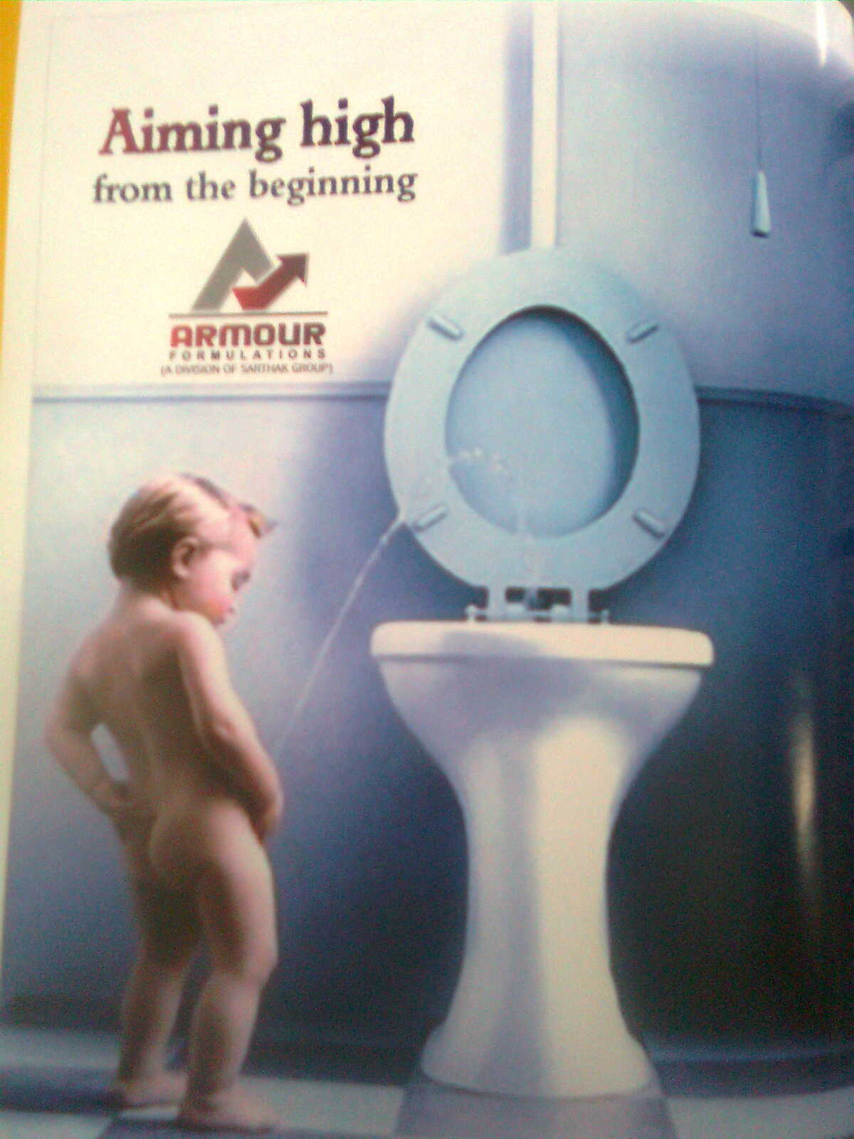
Thanks Coimbatore ISA
Appeal to PGs
In Exams and Life
Aim Highhhhh !

